Slide 1
Tactics, Techniques, and Procedures (TTP)

Slide 2
Learning outcome
LO 1 : Define basic principal of computer security

Slide 3
Subtopics
Tactics, Techniques, and Procedures
Introduction to MITRE ATT&CK

Slide 4
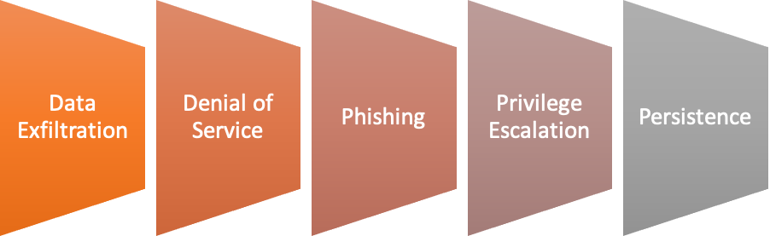
TTP
Tactics
Tactics are high-level, strategic goals that threat actors aim to achieve during an attack. They represent the overarching objectives of an attack. Some common cyberattack tactics include:

Slide 5
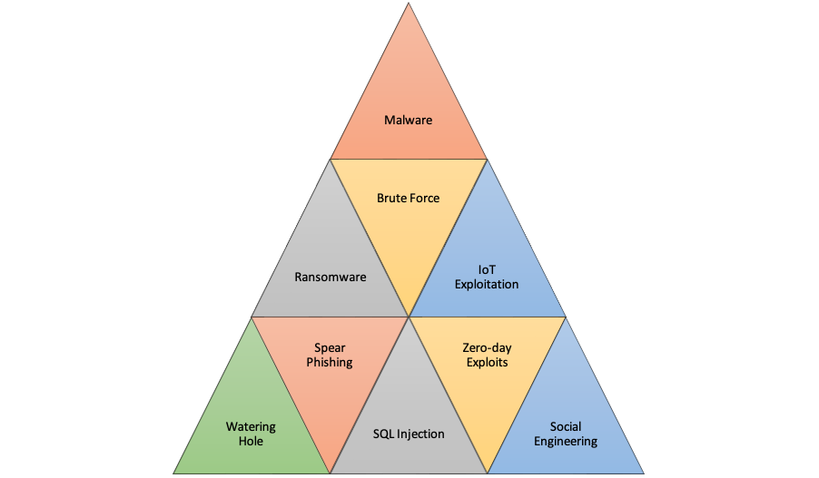
TTP
Techniques
Techniques are the specific methods and tools that threat actors employ to accomplish their tactics. These are more detailed and tactical than tactics. Techniques can vary significantly depending on the attacker's goals and capabilities.

Slide 6
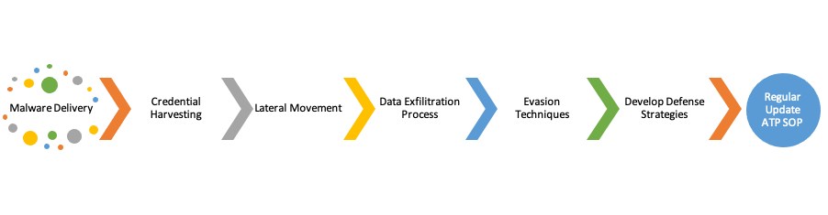
TTP
Procedures
Procedures represent the step-by-step processes or workflows that threat actors follow when conducting an attack. These are highly detailed and specific to the chosen technique and the tools involved. Procedures provide a granular understanding of how an attack is executed.

Slide 7
why ttp?
Detect Attacks: Recognize patterns and behaviours associated with known TTPs to identify ongoing or potential attacks.
Develop defence strategies: Design security measures that specifically target the techniques and procedures used by threat actors.
Enhance Incident Response: Respond effectively to security incidents by understanding how attackers operate and what steps they take.
Share Threat Intelligence: Communicate threat information with other organizations and security communities to help them defend against similar attacks.
Improve Threat Hunting: Proactively seek out signs of compromise in the network based on known TTPs.

Slide 8

MITRE ATT&CK
What is ATT&CK?
A knowledge base of adversary behavior
Based on real-world observations
Free, open, and globally accessible
A common language for threat intelligence
Community-driven
There are 3 elements covered in
ATT&CK: enterprise, mobile, and ICS.

Slide 9
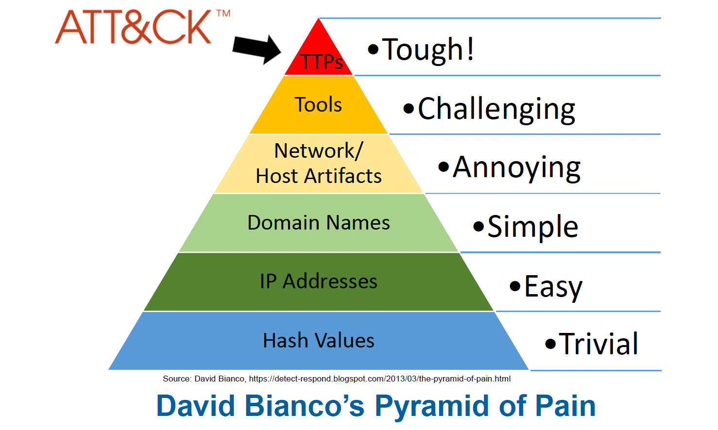
MITRE ATT&CK
The Difficulty of Identifying TTPs

Slide 10
MITRE ATT&CK
Let’s break down ATT&CK components.
Tactics: the adversary’s technical goals.
Example: Initial Access, Privilege Escalation, Defense Evasion, etc.
Techniques: how the goals are achieved.
Example: Access Token Manipulation, Account Discovery, Active Scanning, etc.
Procedures: specific technique implementation.
Example: To do Access Token Manipulation, Stuxnet attempts to impersonate an anonymous token to enumerate bindings in the service control manager.

Slide 11
MITRE ATT&CK
Tactics: the adversary’s technical goals.
https://attack.mitre.org/#

Slide 12
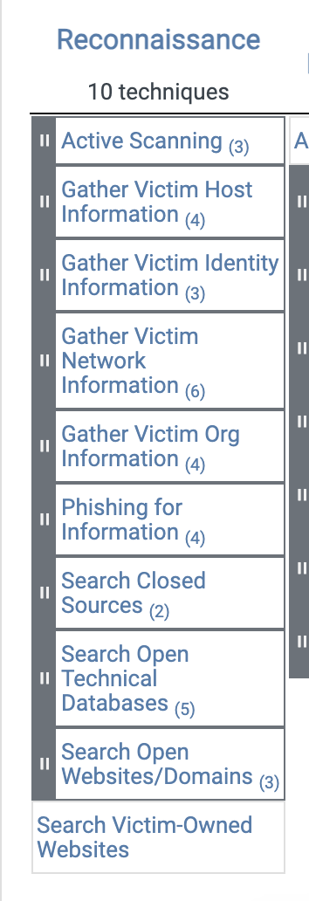
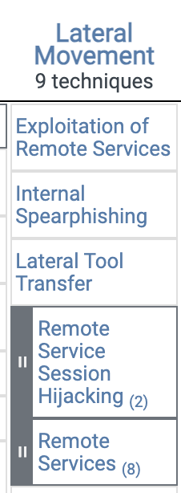
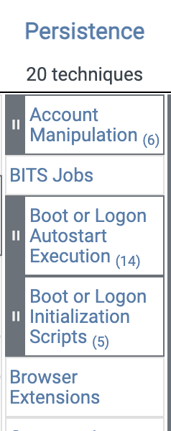
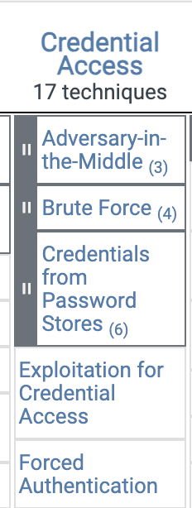
MITRE ATT&CK
Techniques: how the goals are achieved.

Slide 13
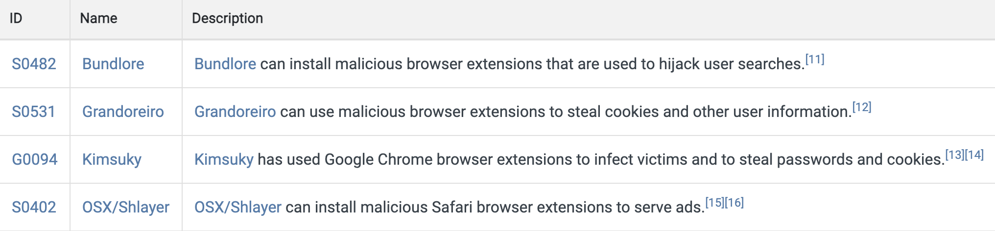
MITRE ATT&CK
Procedures: specific technique implementation.
To achieve persistence (tactics) through browser extension (techniques):
https://attack.mitre.org/techniques/T1176/

Slide 14
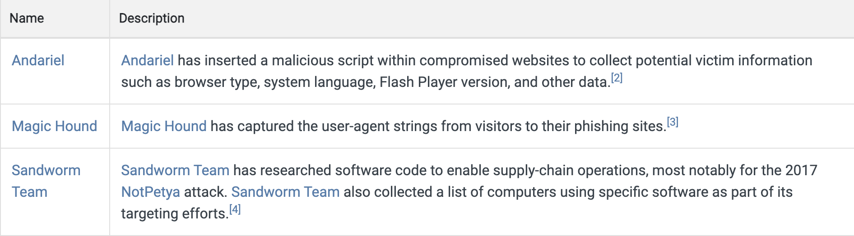
MITRE ATT&CK
Procedures: specific technique implementation.
To achieve reconnaisance (tactics) by Gather Victim Host Information
(techniques):
https://attack.mitre.org/techniques/T1592/

Slide 15
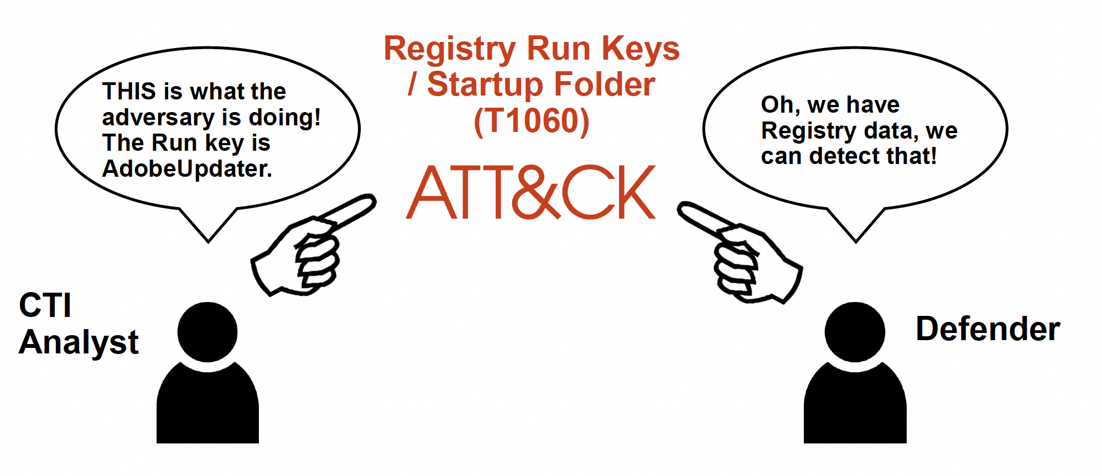
Benefits of MITRE ATT&CK
ATT&CK helps TI analyst to communicate with the system defenders.

Slide 16
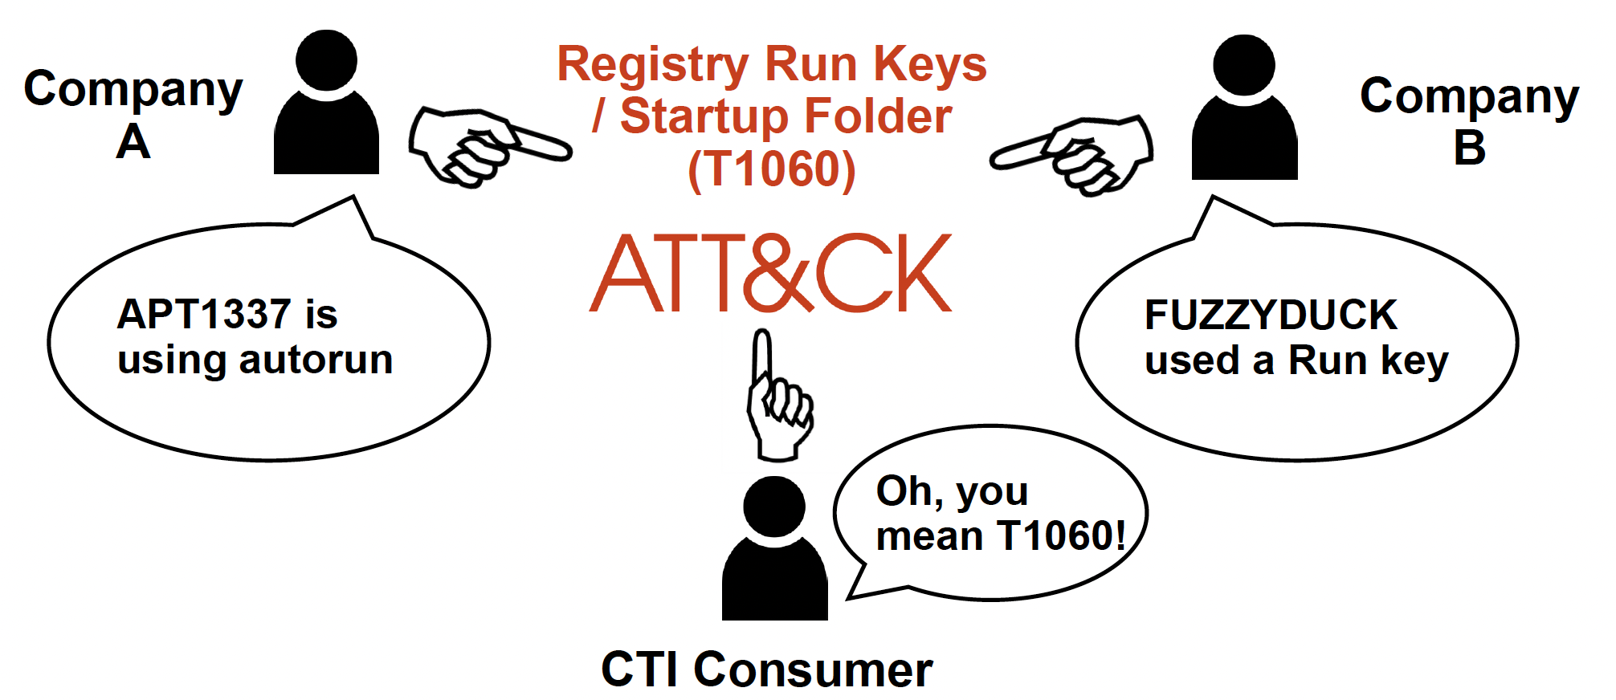
Benefits of MITRE ATT&CK
ATT&CK helps information sharing between organizations

Slide 17
Benefits of MITRE ATT&CK
ATT&CK helps information sharing between organizations

Slide 18
Making recommendations from mitre att&ck
Determine priority techniques
Research how techniques are being used
Research defensive options related to technique
Research organizational capability/constraints
Determine what tradeoffs are for org on specific options
Make recommendations

